Slide 1
Autumn Ossello
It’s a Recipe Book!

Slide 2
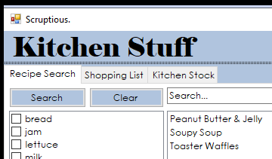
It’s all mine!
The COOLEST part of my program is that I got to make it look how I want.

Slide 3

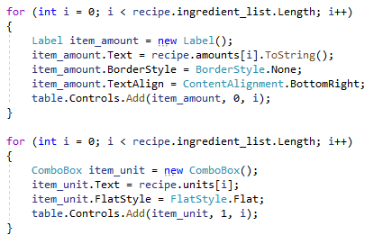
TextBox Who?
Why name elements if you can just shove them into other elements?

Slide 4
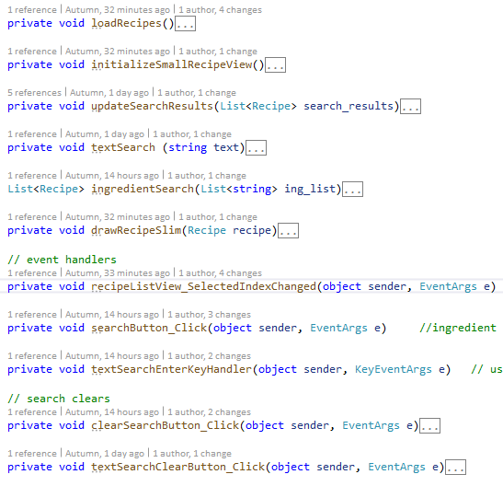
If I could do it all over again, I would…
Not write code until 5am…

Slide 5
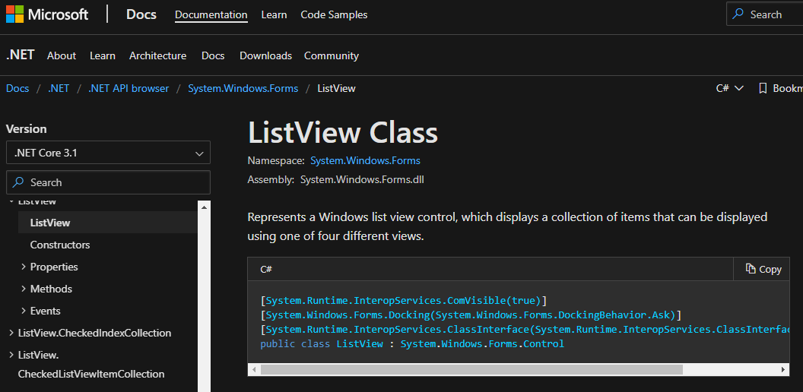
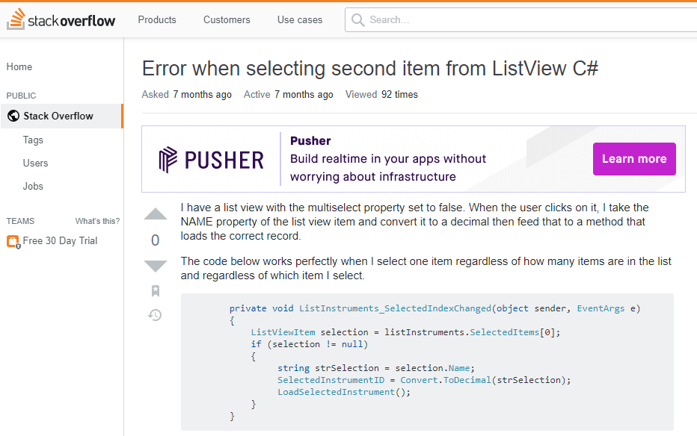
The thing that I learned the most was…
WinForms!
Documentation!
Stack Overflow!
My mental limits!
How long I can sit on a footstool before loosing feeling in my legs!

Slide 6
To the Future ->>>
Recipe Editing, Full Recipe View and Cooking View
Additional Features
Recommended Pairings
Pantry Log
Shopping List
End Goals
Meal Planning
Minimizing Food Waste
Mobile App

